Slide 1
Pop Culture Opinions
What fashions, foods, and memes are most popular?

Slide 2
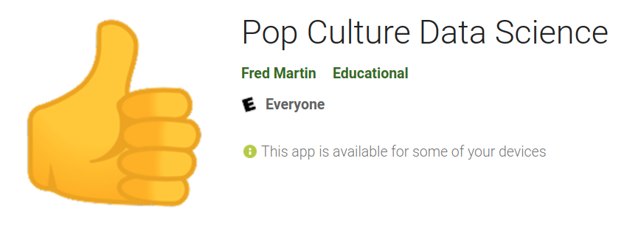
Pop Culture app

Slide 3
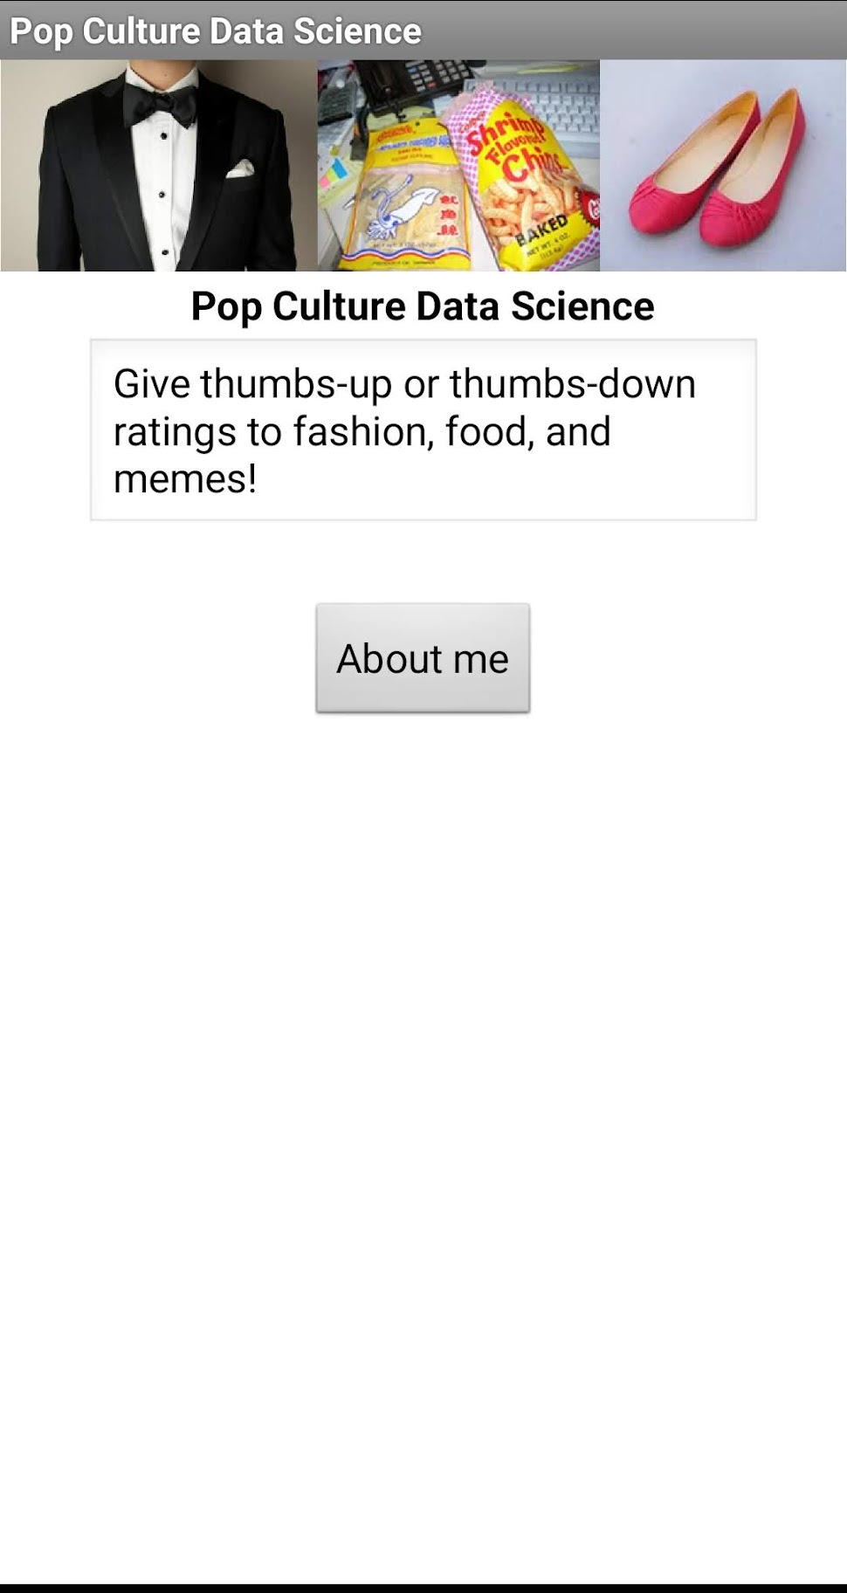
Welcome screen

Slide 4
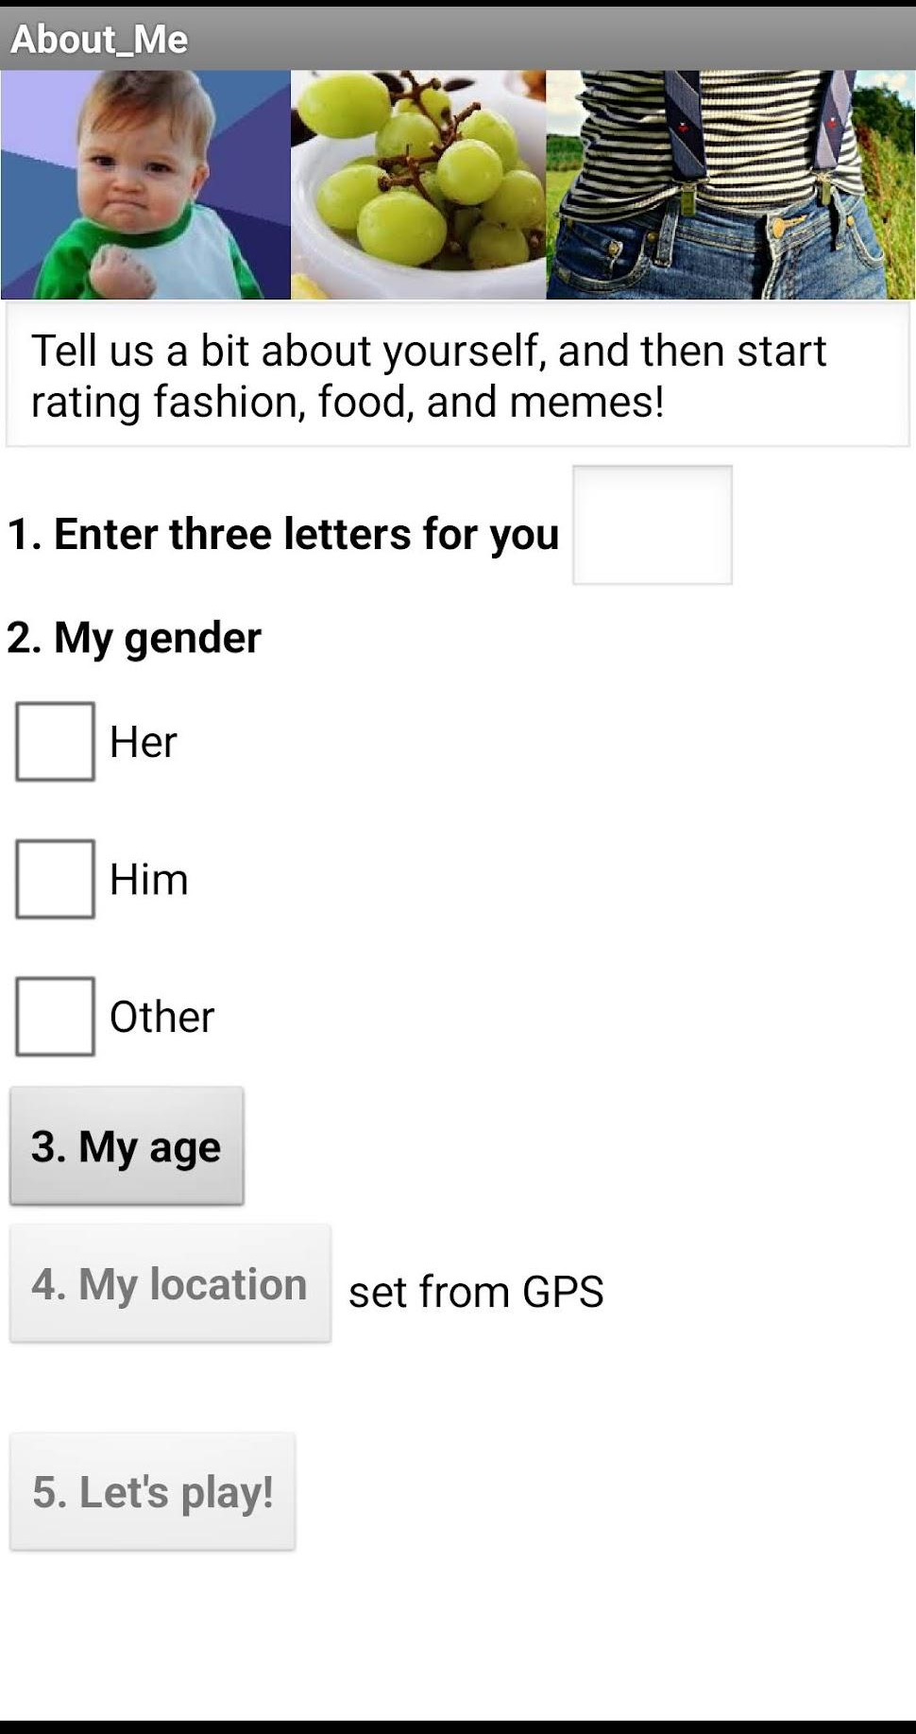
About me screen
Use first 3 letters of your code word
This button may be cut off but it’s still there!

Slide 5
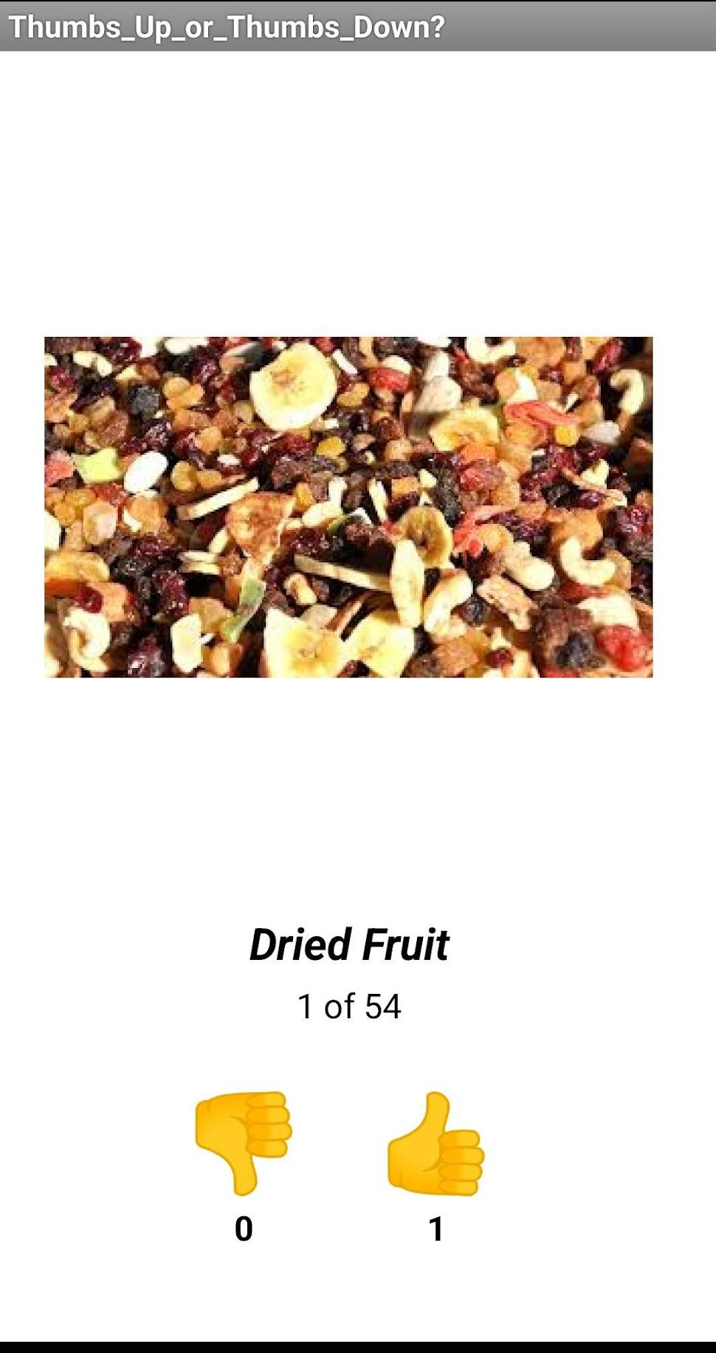
Rating screen
Press thumbs-down for zero or thumbs-up for one
(items will display in a random order)

Slide 6
Let’s see the results!

Slide 7
tinyurl.com/isensepop

Slide 8
Questions!
Which things are the most popular?
Which things are the least popular?
What about you all in this class - what do you think?
Who likes items the most - girls, boys, or non-binary persons?
What is the popularity of nuts?

Slide 9
discussion!
What did you like?
What other questions about the results would you ask?
Would you want to make your own quiz app? If so, what things would you include?

